Slide 1
Introduction to CI/CD using Jenkins

Slide 2
Agenda
Introduction to CI/CD
Overview of Jenkins
Installing Jenkins
Continuous Integration with Jenkins
Continuous Delivery with Jenkins

Slide 3
Introduction to CI /CD

Slide 4
What is Continuous Integration (CI)?
Continuous Integration is a development practice in which the developers are required to commit changes to the source code in a shared repository several times a day or more frequently.
Every commit made in the repository is then built. This allows the teams to detect the problems early.
Continuous Integration tool is also used for automating building and testing applications
Using CI , helps companies to save time on debugging and gives more time to add new features

Slide 5
What is Continuous Delivery (CD)?
Continuous delivery (CD) is a software release approach in which software can be released to production rapidly with a high degree of automation
CD is the ability to have new features, configuration changes, bug fixes and experiments into production environment in a sustainable way.
Low Risk Releases, Faster time to Market , Lower costs and Higher quality are the important benefits which companies can get using Continuous Delivery principles.

Slide 6
Benefits of CI/CD
Smaller Code Changes
Faster Mean time to Resolution (MTTR)
Increases Team Transparency and Accountability
Faster Releases & Effective Tests
Customers are happy
Reduce Costs
Easy Maintenance

Slide 7
CI /CD Features
End-to-end security
Ability to rollback with a fully reproducible audit trail
Built-in observability and alerting
A fast Mean Time to Deployment as well as a Fast Mean Time to Recovery
Simple developer experience and workflows

Slide 8
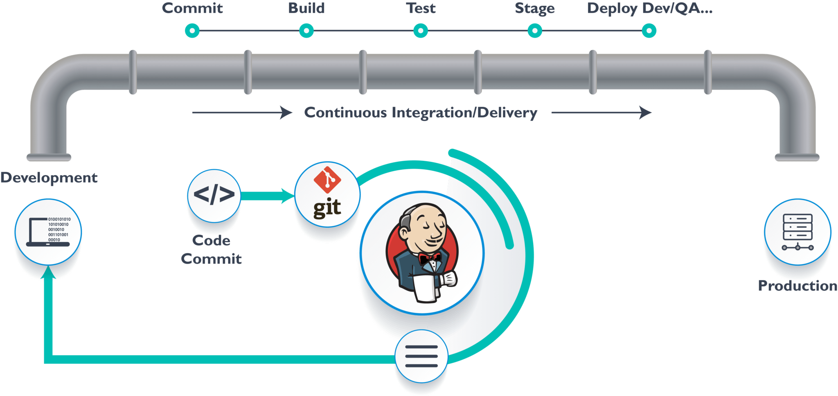
Continuous Integration / Continuous Delivery (CI/CD)

Slide 9
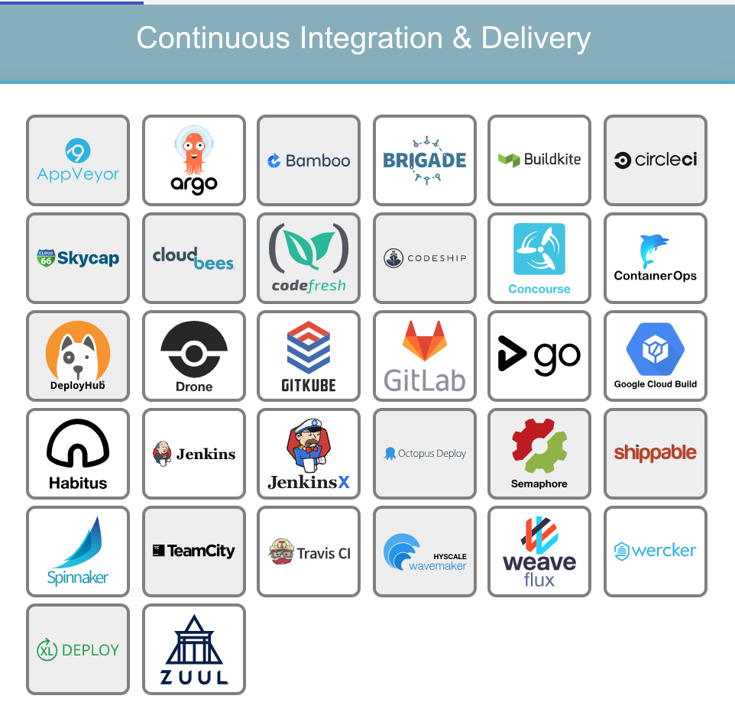
CI/CD tools in the Market

Slide 10
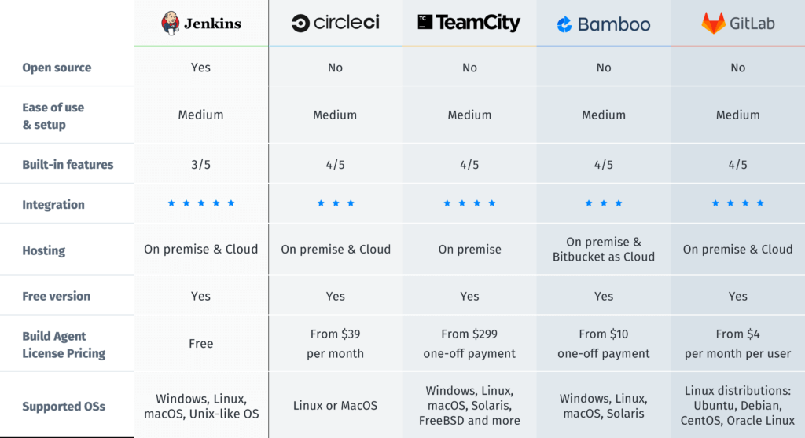
Comparison of CI/CD Tools

Slide 11
Introduction to Jenkins

Slide 12

Overview of Jenkins
Open source CI/CD tool written in Java with plugins built for Continuous Integration and Continuous Delivery purpose.
Used for building and testing software projects continuously making it easier for developers to integrate changes to the project and making it easier for users to obtain a fresh build.
It is used to automate all tasks related to building , testing and delivering software

Slide 13
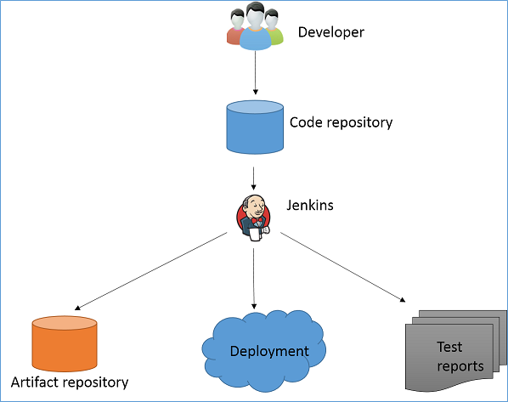
Jenkins Workflow

Slide 14
Jenkins Benefits & Adoption
It is an open source tool with great community support.
It is easy to install.
It is free of cost.
It is built with Java and hence, it is portable to all the major platforms.
Jenkins is widespread, with more than 147,000 active installations and over 1 million users around the world.
Jenkins is interconnected with well over 1,000 plugins that allow it to integrate with most of the development, testing and deployment tools.

Slide 15
Jenkins Integration

Slide 16
Jenkins Architecture

Slide 17
Important Jenkins Terms
Job/Project: Refers to runnable tasks that are controlled / monitored by Jenkins.
Node/Slave: Slaves are computers that are set up to build projects for a master. Jenkins runs a separate program called "slave agent" on slaves. When slaves are registered to a master, a master starts distributing loads to slaves. Term Node is used to refer to all machine that are part of Jenkins grid, slaves and master.
Successful build : A build is successful when the compilation reported no errors.
Unstable build: A build is unstable if it was built successfully and one or more publishers report it unstable. For example if the JUnit publisher is configured and a test fails then the build will be marked unstable.
Ref: https://jenkins.io/doc/book/glossary/

Slide 18
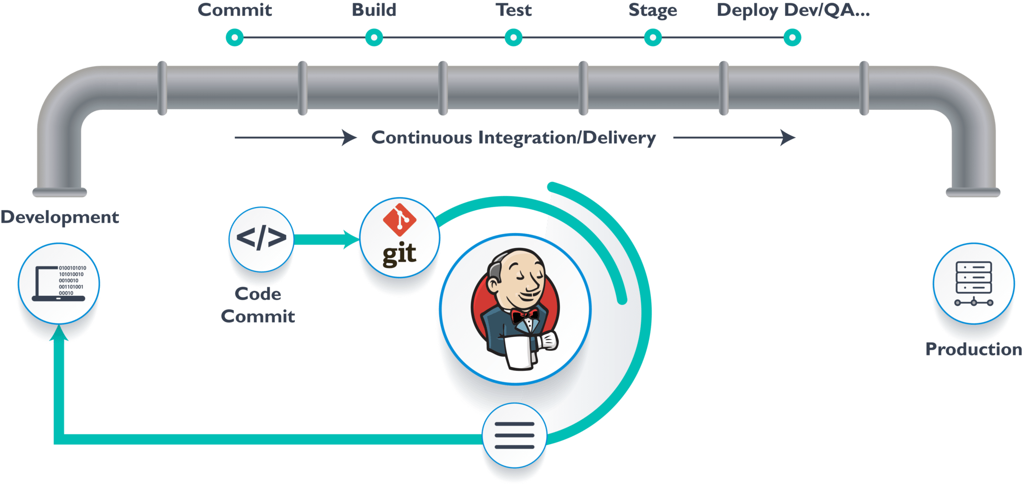
Jenkins Lifecycle

Slide 19
Installing & Configuring Jenkins

Slide 20
Installing Jenkins
Jenkins is typically run as a standalone application in its own process with the built-in Java servlet container/application server (Jetty).
Jenkins can also be run as a servlet in different Java servlet containers such as Apache Tomcat or GlassFish.
Prerequisites:
Minimum hardware requirements:
256 MB of RAM
1 GB of drive space (although 10 GB is a recommended minimum if running Jenkins as a Docker container)
Recommended hardware configuration for a small team:
1 GB+ of RAM
50 GB+ of drive space

Slide 21
Jenkins Releases
The Jenkins project produces two release lines, LTS and weekly. Depending on your organization's needs, one may be preferred over the other.
Both release lines are distributed as .war files, native packages, installers, and Docker containers.
LTS (Long-Term Support) releases are chosen every 12 weeks from the stream of regular releases as the stable release for that time period.
Weekly -A new release is produced to deliver bug fixes and features to users and plugin developers.

Slide 22
Platforms Supported
Jenkins could be installed and configured on the below platforms:
Docker Platform
Linux OS – Debian, Centos and Fedora
Windows OS
Mac OS
Solaris, Omni OS, Smart OS, etc..

Slide 23
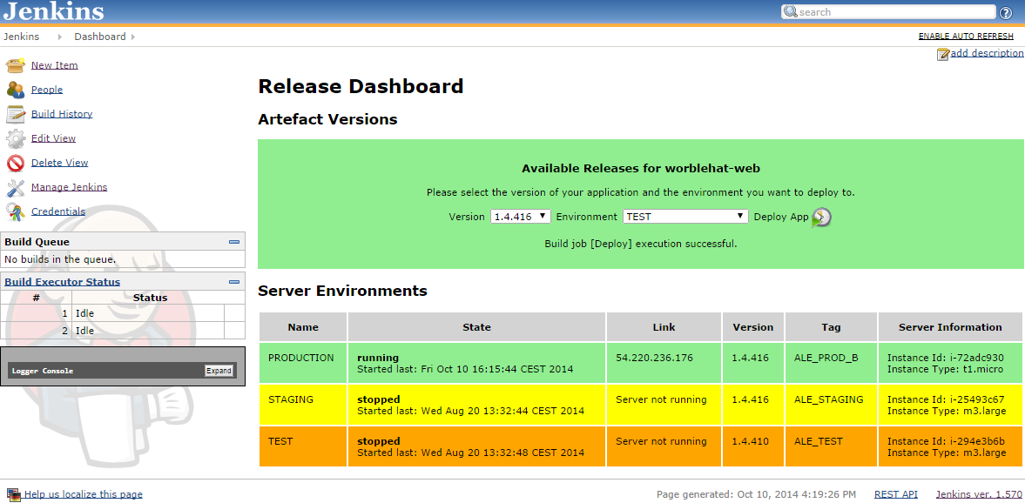
Jenkins Dashboard

Slide 24
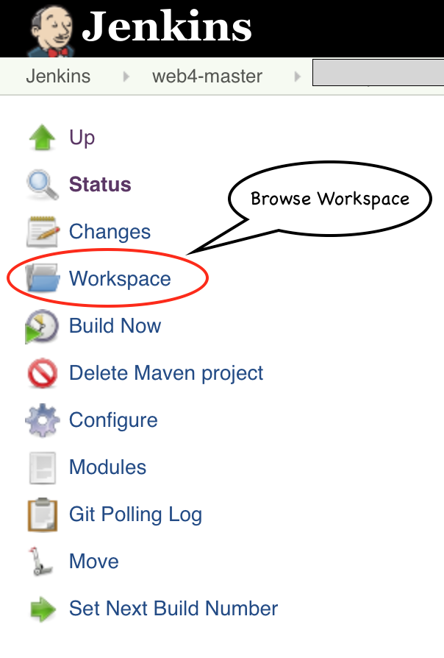
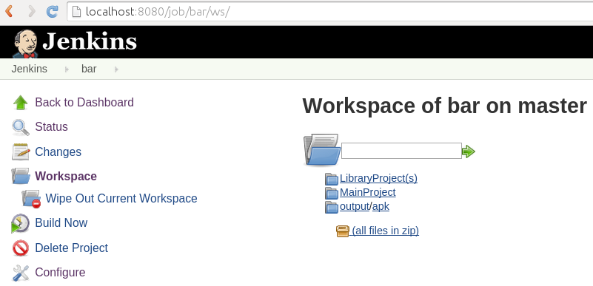
Jenkins Workspace
The workspace directory is where Jenkins builds your project
It contains the source code Jenkins checks out, plus any files generated by the build itself.

Slide 25
Managing Plugins
Plugins are the primary means of enhancing the functionality of a Jenkins environment to suit organization- or user-specific needs.
There are over a thousand different plugins which can be installed on a Jenkins master and to integrate various build tools, cloud providers, analysis tools, and much more.
Plugins can be automatically downloaded, with their dependencies, from the Update Center. The Update Center is a service operated by the Jenkins project which provides an inventory of open source plugins which have been developed and maintained by various members of the Jenkins community.

Slide 26
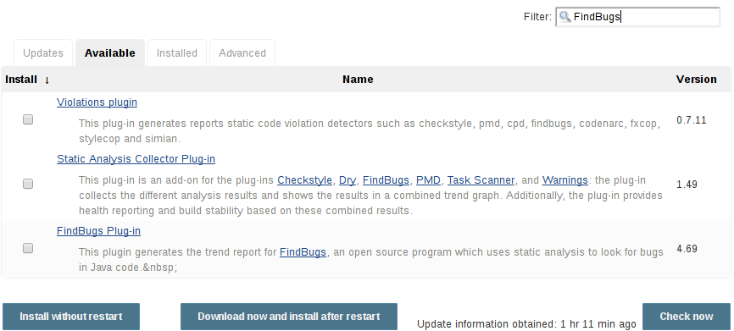
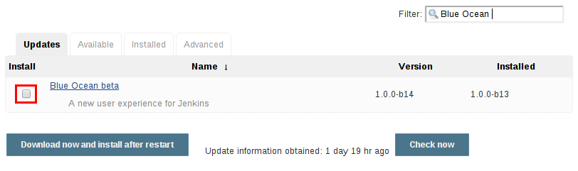
Installing & Updating Plugins

Slide 27
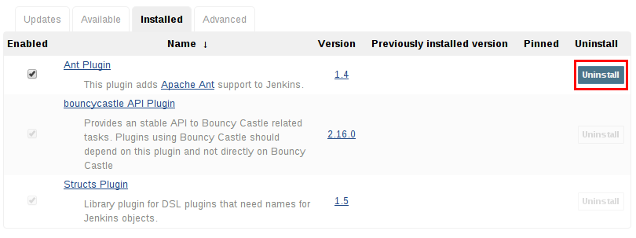
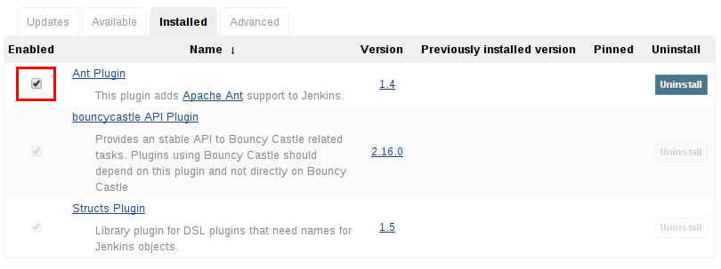
Uninstalling & Disabling Plugin

Slide 28
Continuous Integration with Jenkins

Slide 29
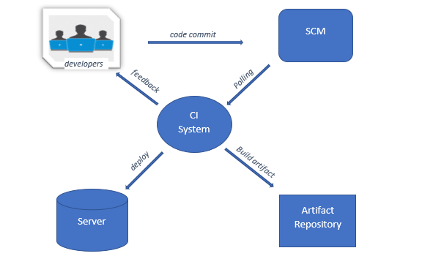
Source Code Polling

Slide 30
Source Code Polling
Developers develop the source code in their local machine and push the code to the central cloud repository (SCM) like GitHub or Bitbucket
Jenkins will poll the source code from SCM and build the artefacts in the configured environment.
Once the CI build is completed post build activities will start.
Post Build activities includes - Deploying to server, storing build artifacts, displaying the test results and sending the feedback to developers are some examples for post build activities.

Slide 31
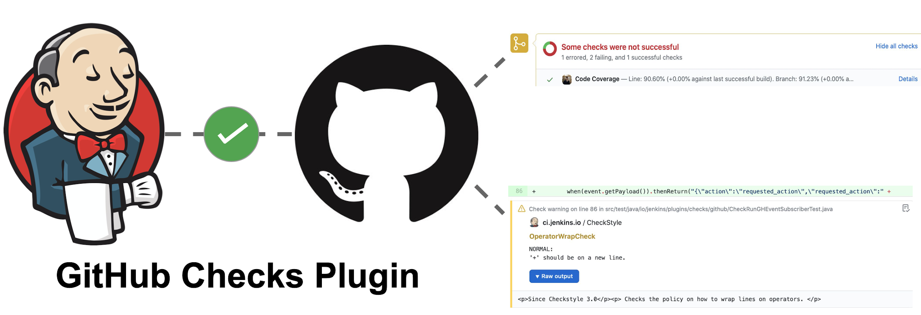
Triggering Jenkins Build
GitHub plugin for Jenkins is the most basic plugin for integrating Jenkins with GitHub projects.
Using GitHub plugin along with Webhooks enables to schedule build, pull the code and data files from GitHub repository and automatically triggers each build on the Jenkins server after each commit in the GitHub repository.

Slide 32
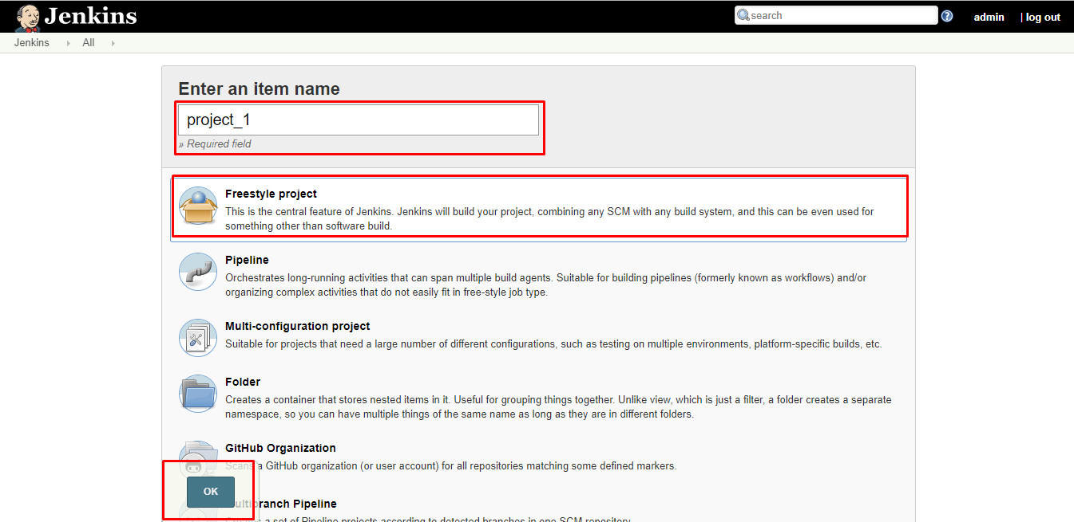
Jenkins Builds
Jenkins project is a repeatable build job which contains steps and post-build actions.
The freestyle build job is a highly flexible and easy-to-use option.
Freestyle job is easy to set up and configure

Slide 33
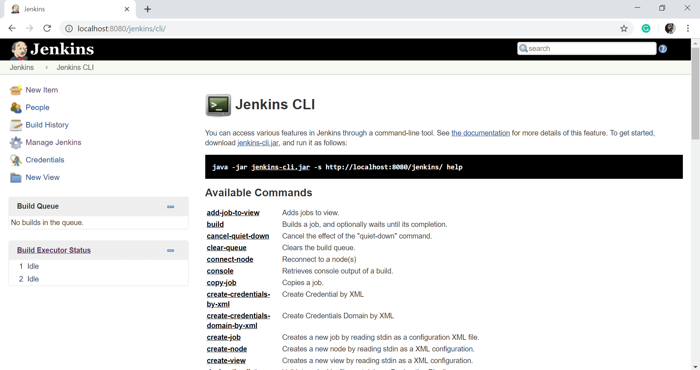
Jenkins CLI
Jenkins has a built-in command line interface that allows you to access Jenkins from a script or from your shell. This is convenient for automation of routine tasks, bulk updates, trouble diagnosis, and so on.
This interface is accessed via the Jenkins CLI client, which is a Java JAR file distributed with Jenkins.
Running a CLI command
The general syntax is as follows (the design is similar to tools like svn/git):
java -jar jenkins-cli.jar [-s JENKINS_URL] command [options...] [arguments...]
Ref: https://wiki.jenkins.io/display/JENKINS/Jenkins+CLI

Slide 34
Jenkins Architecture

Slide 35

Jenkins Master
Main Jenkins server is the Master.
The Master’s job is to handle:
Scheduling build jobs.
Dispatching builds to the slaves for the actual execution.
Monitor the slaves (possibly taking them online and offline as required).
Recording and presenting the build results.
A Master instance of Jenkins can also execute build jobs directly.

Slide 36

Jenkins Slave Node
A Slave is a Java executable that runs on a remote machine.
Following are the characteristics of Jenkins Slaves:
It hears requests from the Jenkins Master instance.
Slaves can run on a variety of operating systems.
The job of a Slave is to do as they are told to, which involves executing build jobs dispatched by the Master.
Projects can be configured to always run on a particular Slave machine, or a particular type of Slave machine, or simply let Jenkins pick the next available Slave.

Slide 37
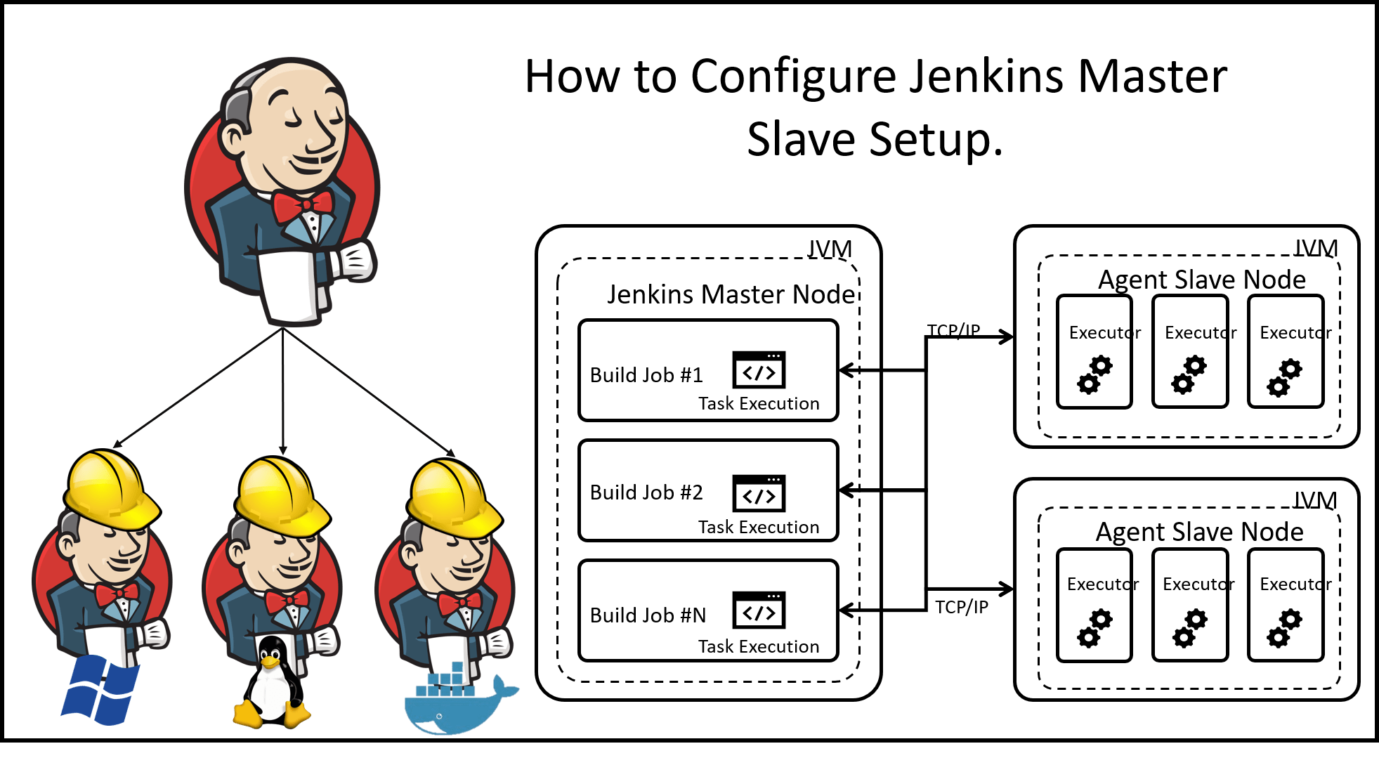
Configure Jenkins Master Slave Setup

Slide 38
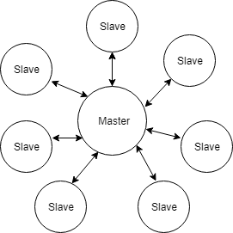
Jenkins Distributed Build
Master can delegate the workload of building projects to “slave” nodes. The projects built in this manner is referred to as “Distributed Builds”.
Once the Master / Slave is setup , this process is automatic
Stickiness to a particular machine can also be specified .
Slave agent and Jenkins master needs to establish a bi-directional communication ( TCP/IP) in order to operate.
Use Cases :
Meet the requirement of different build environment for different projects.
Building different environments to test builds.

Slide 39
Support for Build Tools (Gradle, Maven, ANT)
Ant plugin adds Apache Ant support to Jenkins. This functionality used to be a part of the core, but as of Jenkins 1.431, it was split off into separate plugins.
Maven Integration plugin is a plugin that helps us to build projects that use Apache Maven in Jenkins. In this tutorial, I will guide you how to install this plugin to be able to use it.
Gradle plugin makes it possible to invoke a Gradle build script as the main build step. It also allows detecting Build Scans in arbitrary console logs, for Maven and Gradle builds and display them in the Jenkins UI.

Slide 40
Parameterized Build & Trigger
Build parameters allows to pass data into Jenkins jobs. Eg: git branch name, secret credentials, hostnames ,ports, etc.
Jenkins job or pipeline can be parameterized by checking the box on the General settings tab that says This project is parameterized:
Jenkins supports several parameter types.
String: any combination of characters and numbers
Choice: a pre-defined set of strings from which a user can pick a value
Credentials: a pre-defined Jenkins credential
File: the full path to a file on the filesystem
Multi-line String: same as String, but allows newline characters
Password: similar to the Credentials type, but allows us to pass a plain text parameter specific to the job or pipeline
Run: an absolute URL to a single run of another job
Parameterized Trigger plugin allows to trigger new builds when build has completed, with various ways of specifying parameters for the new build.

Slide 41
Scheduling Jobs
CRON job in Jenkins Job build gives 2 options to build your job periodically. Execute job every time when something new is pushed into the repository since the last build.
Trigger the job at some fixed or periodic time intervals of your choices, regardless of the fact that if something is changed or not in your repository.
E.g. :By setting the schedule period to 15 13 * * * you tell Jenkins to schedule the build every day of every month of every year at the 15th minute of the 13th hour of the day.
Jenkins used a cron expression, and the different fields are:
MINUTES: Minutes in one hour (0-59)
HOURS: Hours in one day (0-23)
DAYMONTH: Day in a month (1-31)
MONTH: Month in a year (1-12)
DAYWEEK: Day of the week (0-7) where 0 and 7 are Sunday

Slide 42
Continuous Delivery using Pipelines

Slide 43
What are Pipelines
Jenkins Pipeline is a suite of plugins which supports implementing and integrating continuous delivery pipelines into Jenkins
Pipelines comprise:
Jobs that define what to run. For example, code compilation or test runs.
Stages that define when and how to run. For example, that tests run only after code compilation.
Multiple jobs in the same stage are executed by Runners in parallel, if there are enough concurrent Runners.
If all the jobs in a stage:
Succeed, the pipeline moves on to the next stage.
Fail, the next stage is not (usually) executed and the pipeline ends early.

Slide 44
Benefits of Pipelines
Jenkins pipeline is implemented as a code which allows multiple users to edit and execute the pipeline process.
Pipelines are robust. So if your server undergoes an unforeseen restart, the pipeline will be automatically resumed.
Pause the pipeline process and make it wait to resume until there is an input from the user.
Jenkins Pipelines support big projects. Multiple jobs can be run and also loops can be used in pipelines.

Slide 45
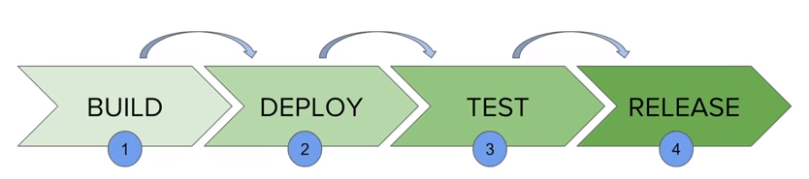
How Build Pipeline Works
It contains a group of states called build, deploy, test and release.
These events are interlinked with each other. Every state has its events, which work in a sequence called a continuous delivery pipeline.
A continuous delivery pipeline is an automated expression to display your process for getting software for version control. Thus, every change made in your software goes through a number of complex processes on its way to being released.
It also involves developing the software in a reliable and repeatable manner, and progression of the built software through multiple stages of testing and deployment.

Slide 46
Jenkins Build Pipeline

Slide 47
Overview of Pipeline as a Code
Describes a set of features that allow Jenkins users to define pipelined job processes with code, stored and versioned in a source repository.
These features allow Jenkins to discover, manage, and run jobs for multiple source repositories and branches — eliminating the need for manual job creation and management.
To use Pipeline as Code, projects must contain a file named JenkinsFile in the repository root, which contains a "Pipeline script."

Slide 48
Overview of Jenkinsfile
Text file that stores the entire workflow as code and it can be checked into a SCM on your local system. This enables the developers to access, edit and check the code at all times.
Written using the Groovy DSL and it can be created through a text/groovy editor or through the configuration page on the Jenkins instance. It is written based on two syntaxes, namely:
1.Declarative pipeline syntax
2.Scripted pipeline syntax
Declarative pipeline is a relatively new feature that supports the pipeline as code concept. It makes the pipeline code easier to read and write. This code is written in a Jenkinsfile which can be checked into a source control management system such as Git.
Scripted pipeline is a traditional way of writing the code. In this pipeline, the Jenkinsfile is written on the Jenkins UI instance

Slide 49
Pipeline Script

Slide 50
Docker Plugin for Jenkins
This plugin allows containers to be dynamically provisioned as Jenkins nodes using Docker. It is a Jenkins Cloud plugin for Docker.
The aim of this docker plugin is to be able to use a Docker host to dynamically provision a docker container as a Jenkins agent node, let that run a single build, then tear-down that node, without the build process .
The Jenkins administrator configures Jenkins with knowledge of one or more docker hosts (or swarms), knowledge of one or more "templates" and Jenkins can then run docker containers to provide Jenkins (slave agent) Nodes on which Jenkins can run builds.
Ref: https://plugins.jenkins.io/docker-plugin/

Slide 51
Using Docker with Pipeline
Pipeline is designed to easily use Docker images as the execution environment for a single Stage or the entire Pipeline.
A user can define the tools required for their Pipeline, without having to manually configure agents.
Any tool which can be packaged in a Docker container can be used with ease by making only minor edits to a Jenkinsfile.
Ref: https://www.jenkins.io/doc/book/pipeline/docker/

Slide 52
THANKS

